Slide 1
Demographics Dashboard Adjustments
Eureka Analytics

Slide 2
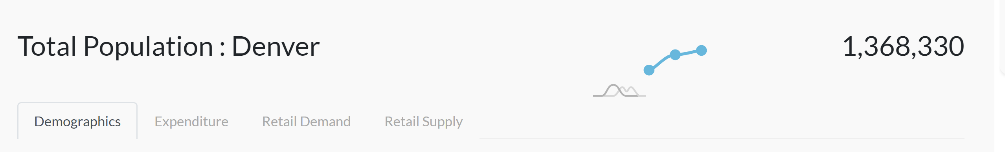

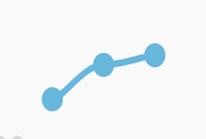
Main Dashboard Views
Current view
Should look like…
Population
Location: Denver

Slide 3
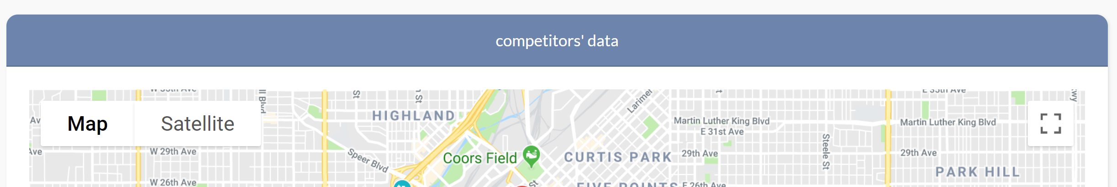
Main Dashboard View – Location Data
Replace label header with Interactive Location Data

Slide 4
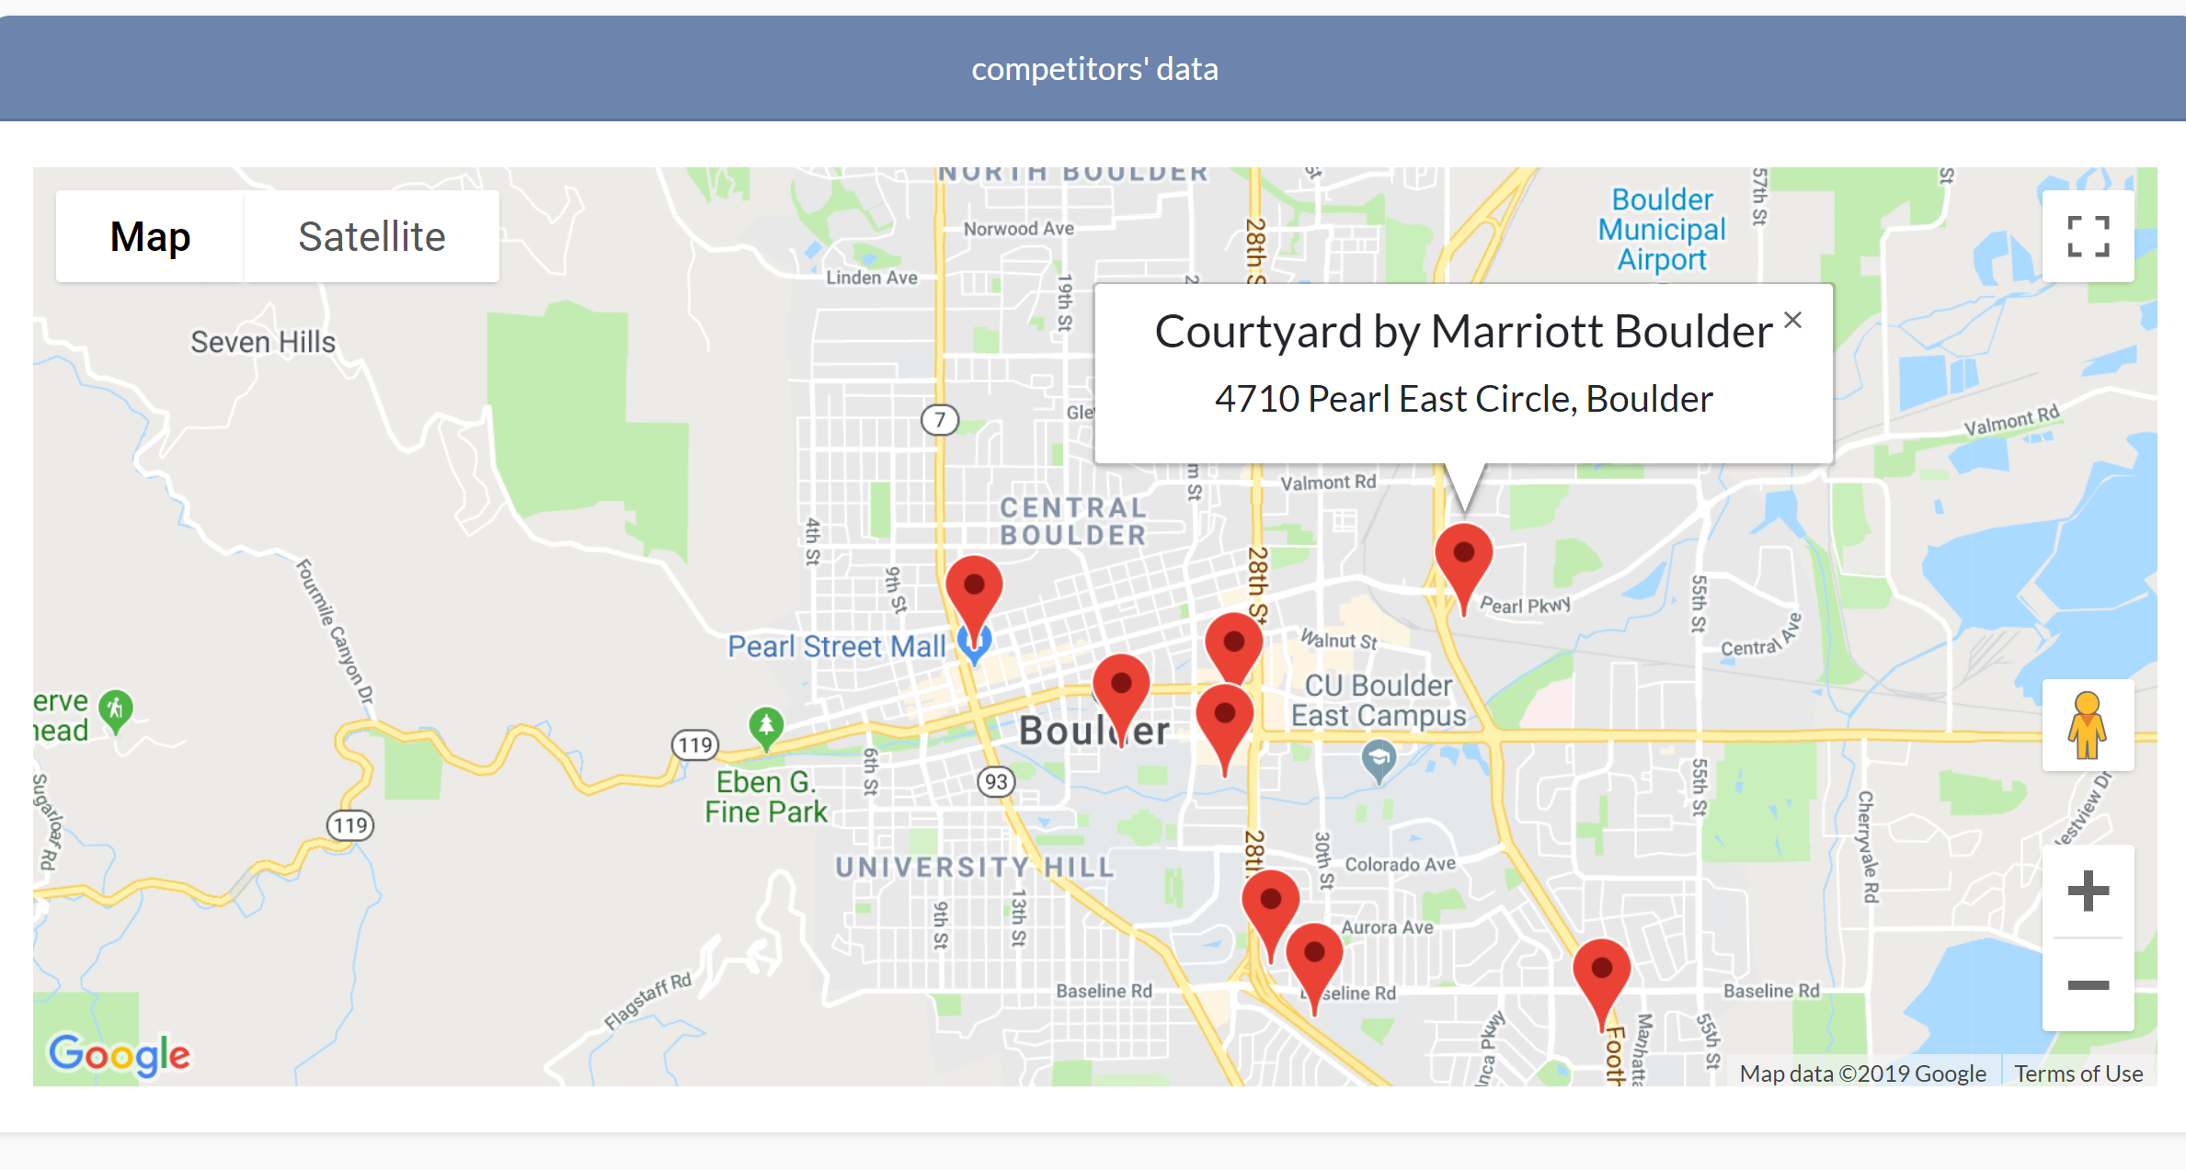


Main Dashboard View – Location Data Filter
Bind Sector – Food, Restaurant, Beverages, etc.

Slide 5
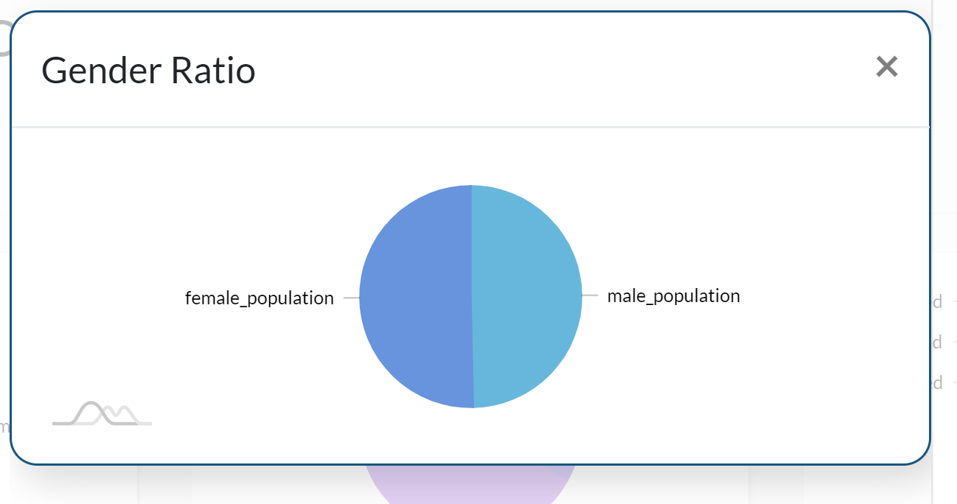
Enlarged Views – Gender Ratio
Size Adjustment ( the graph is too small)
Male Population
Female Population
-1.03% vs. Colorado(State)
+ 3.76% vs. Denver(City)

Slide 6
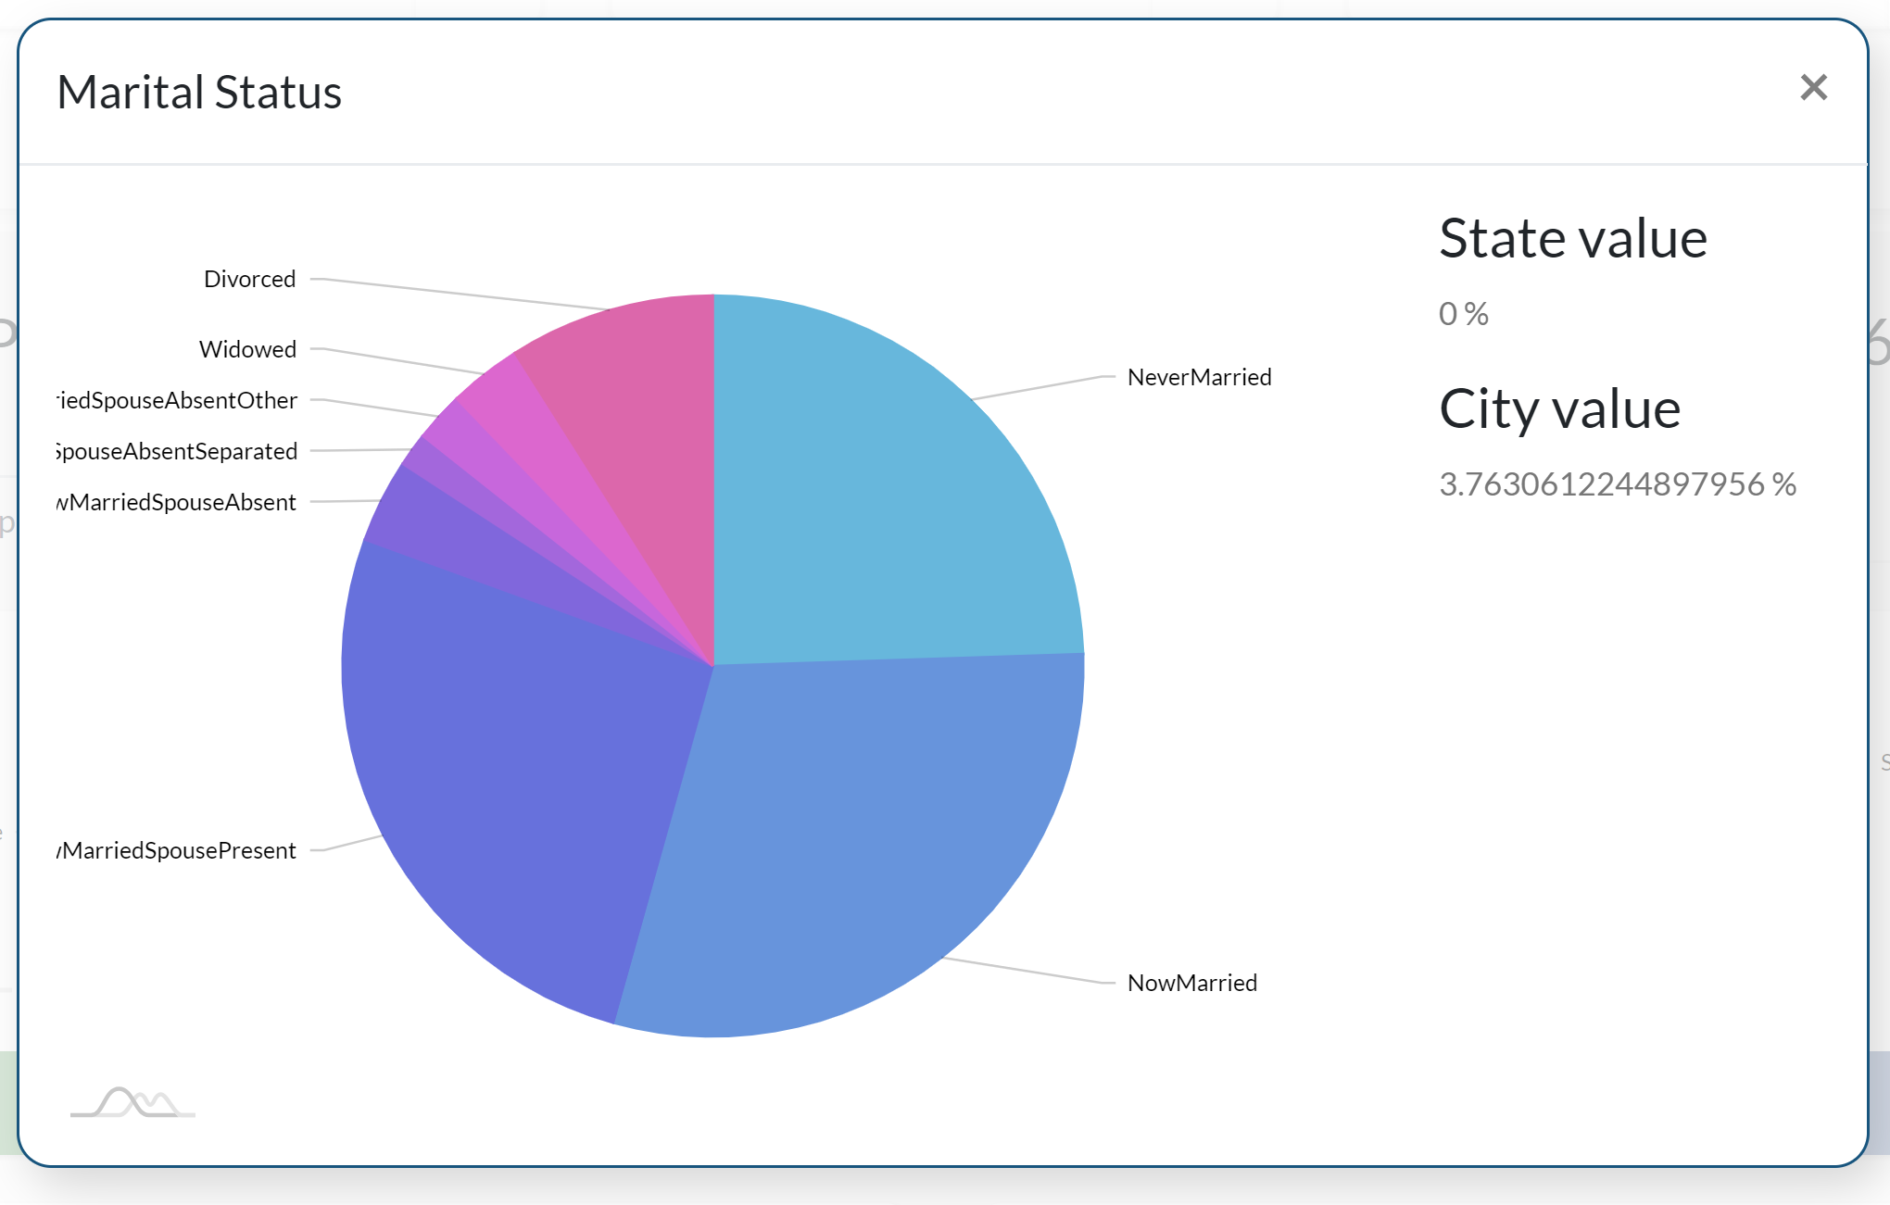



Enlarged Views – Marital Status
Center labels – visibility
Relative views
Limit decimals
Married Spouse Absent
Married Spouse Absent Separated
Married Spouse Present
Etc.
-1.03% vs. Colorado(State)
+ 3.76% vs. Denver(City)

Slide 7
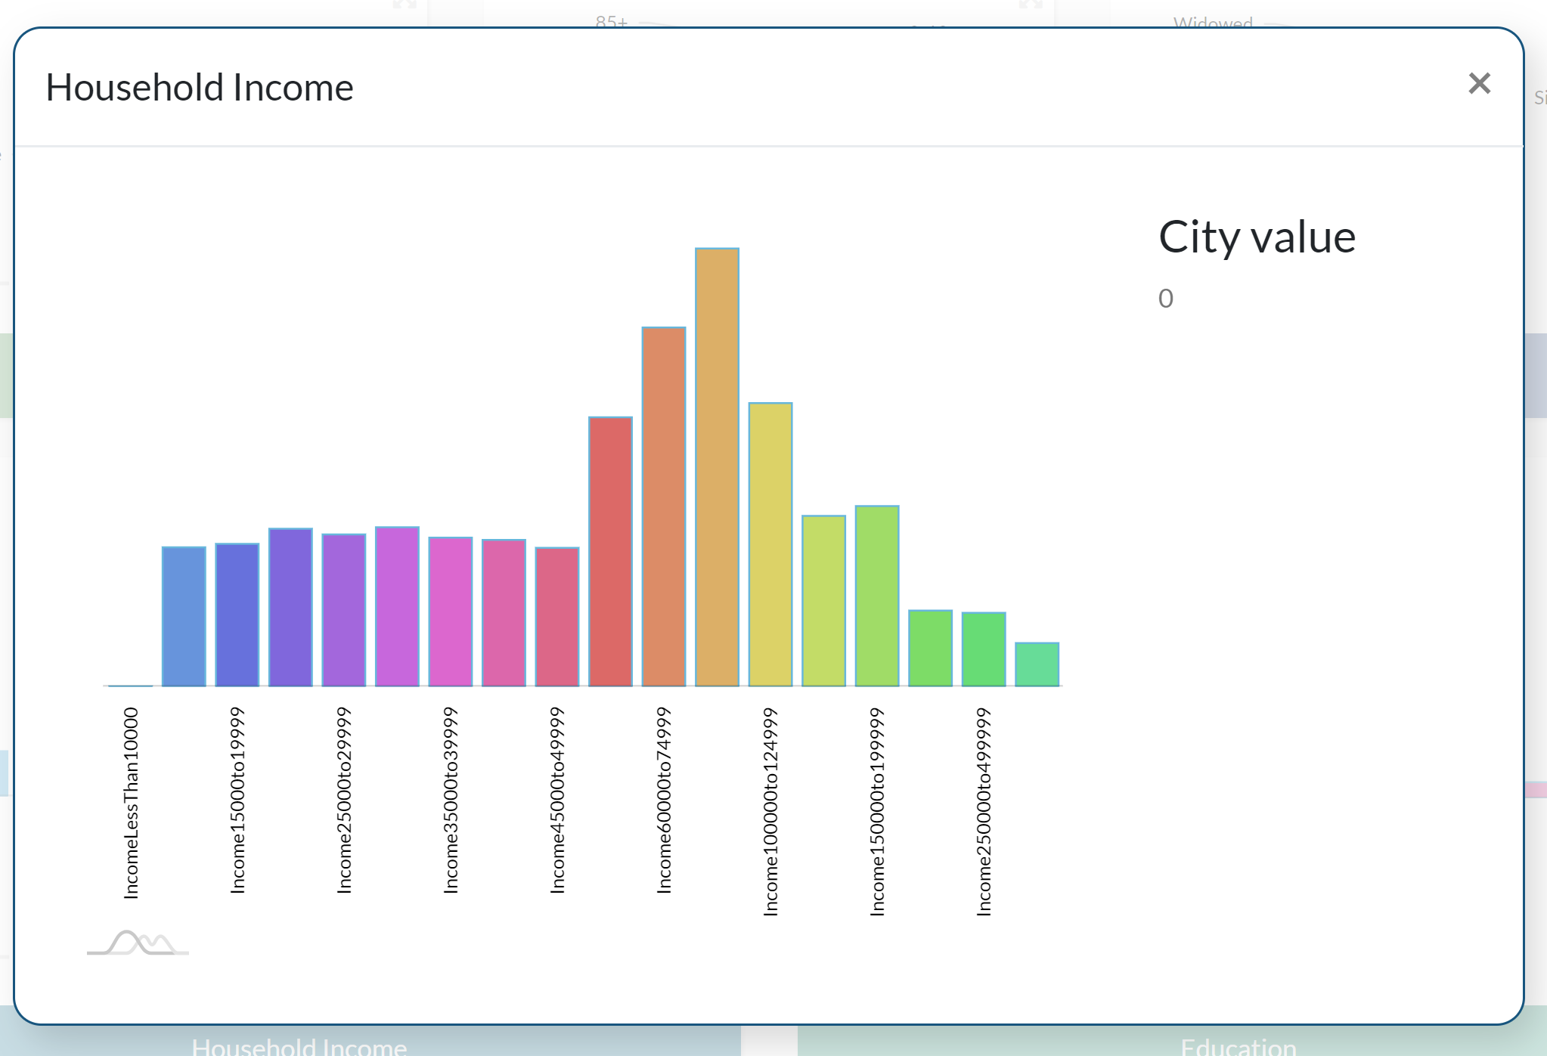
Enlarged Views – Household Income
Median Household Income
Remove “Income” from labels
Insert a comma in the #s and
Replace “to” with a hyphen (-)
-1.03% vs. Colorado(State)
+ 3.76% vs. Denver(City)

Slide 8
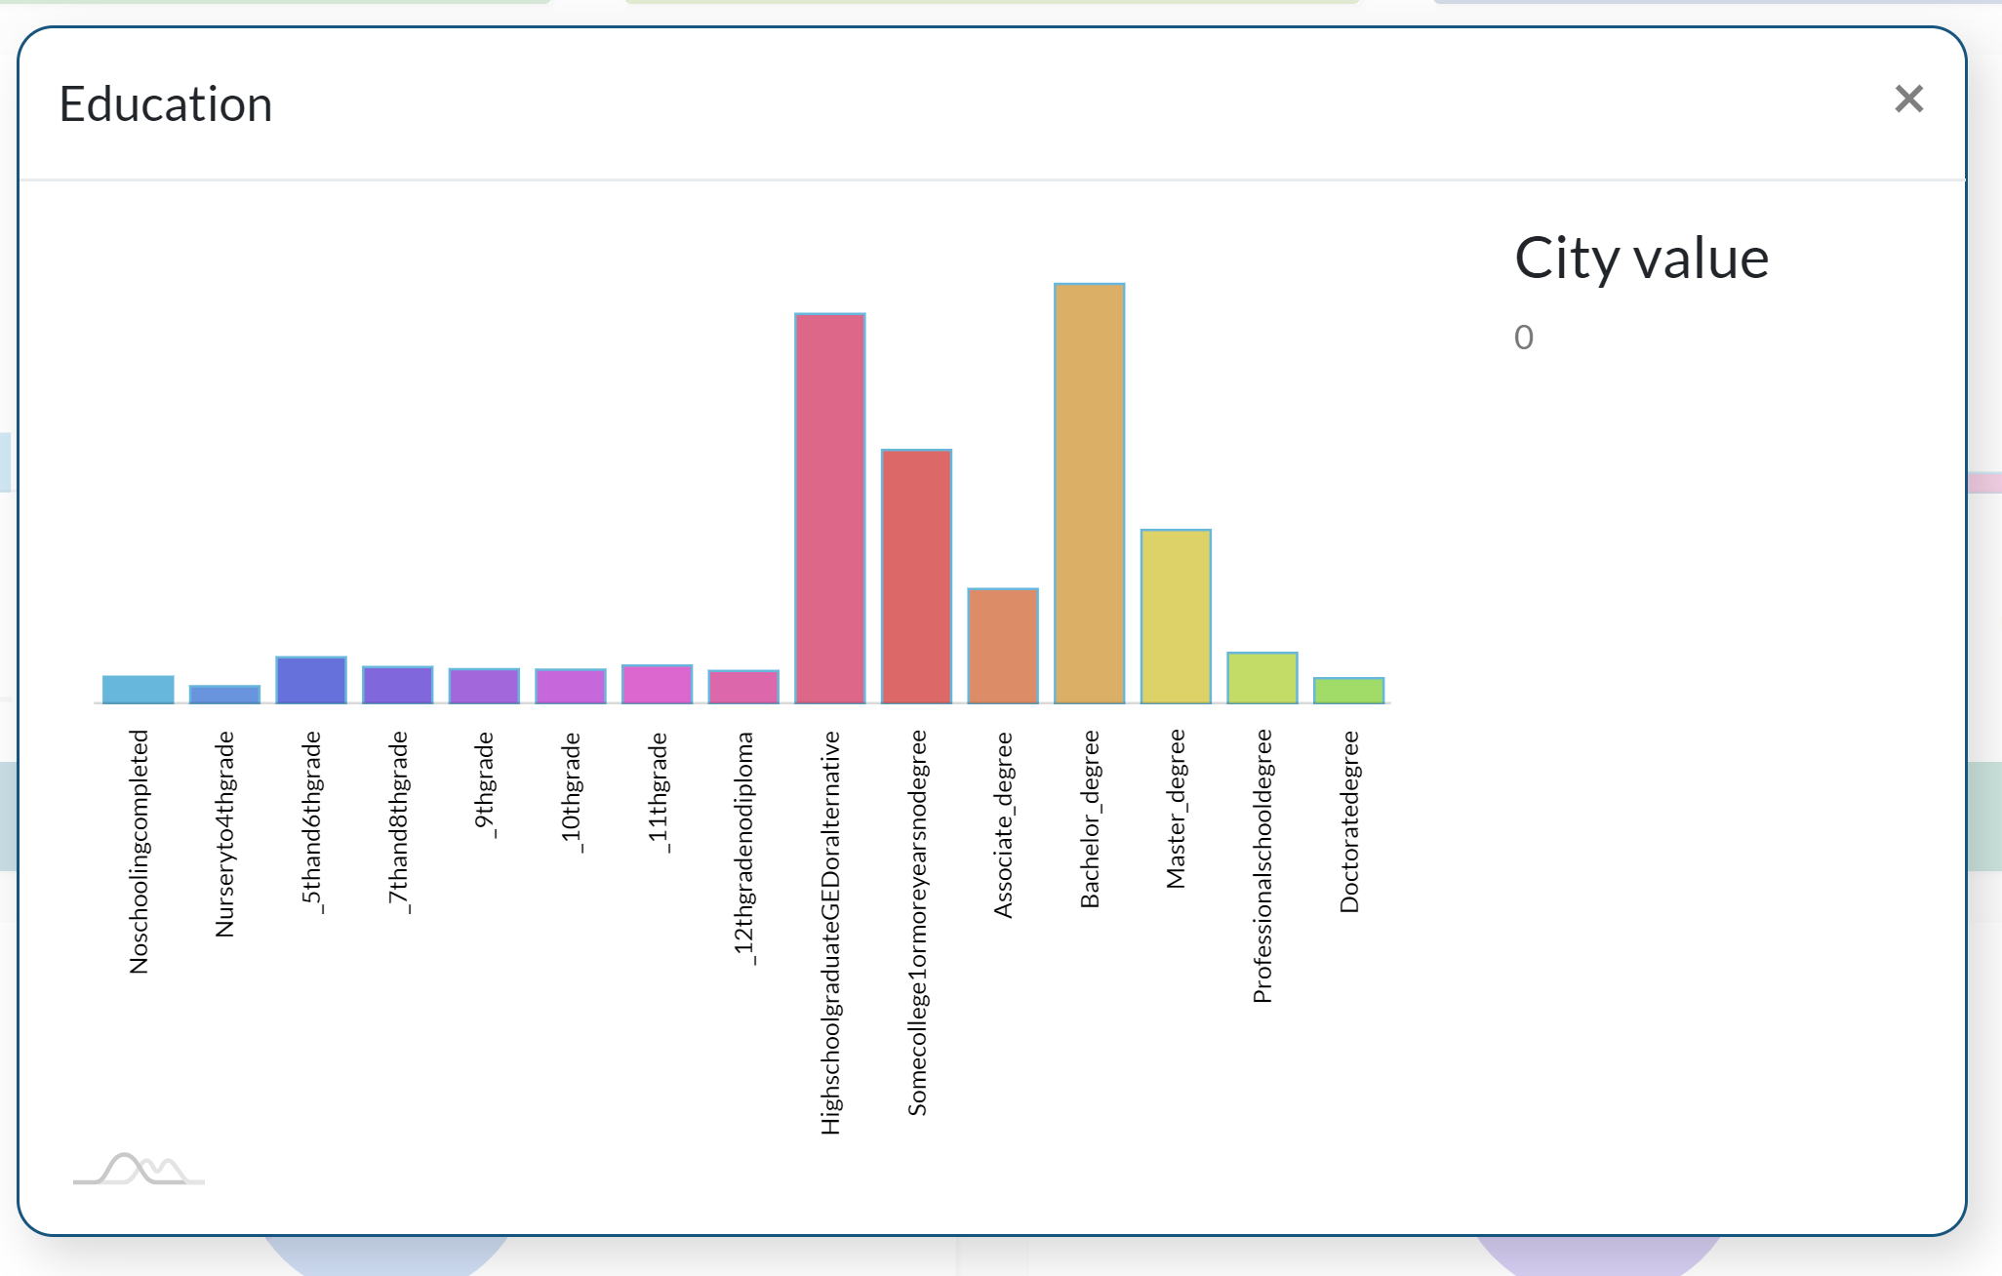
Enlarged Views - Education
No Schooling
Nursery – 4th Grade
5th – 6th Grade
7th – 8th Grade
Etc.
High School Graduate GED
Some College No Degree
-1.03% vs. Colorado(State)
+ 3.76% vs. Denver(City)

Slide 9
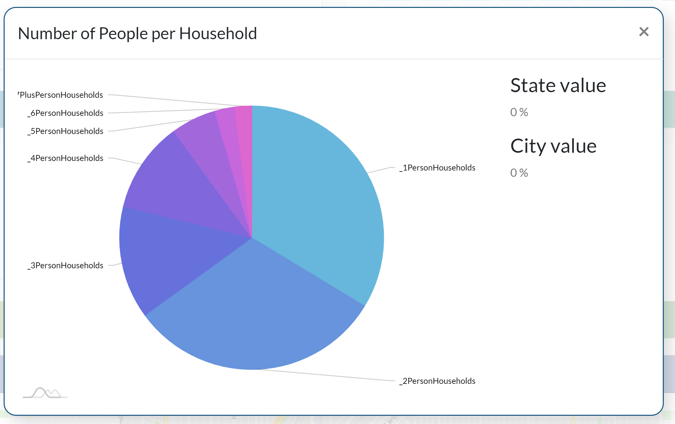
Enlarged Views – Number of People per Households
Remove “Income” from labels
Insert a comma in the #s and
Replace “to” with a hyphen (-)
7 + Persons
6 Persons
5 Persons
Etc.
-1.03% vs. Colorado(State)
+ 3.76% vs. Denver(City)

Slide 10
Alternative Dashboard Options

Slide 11
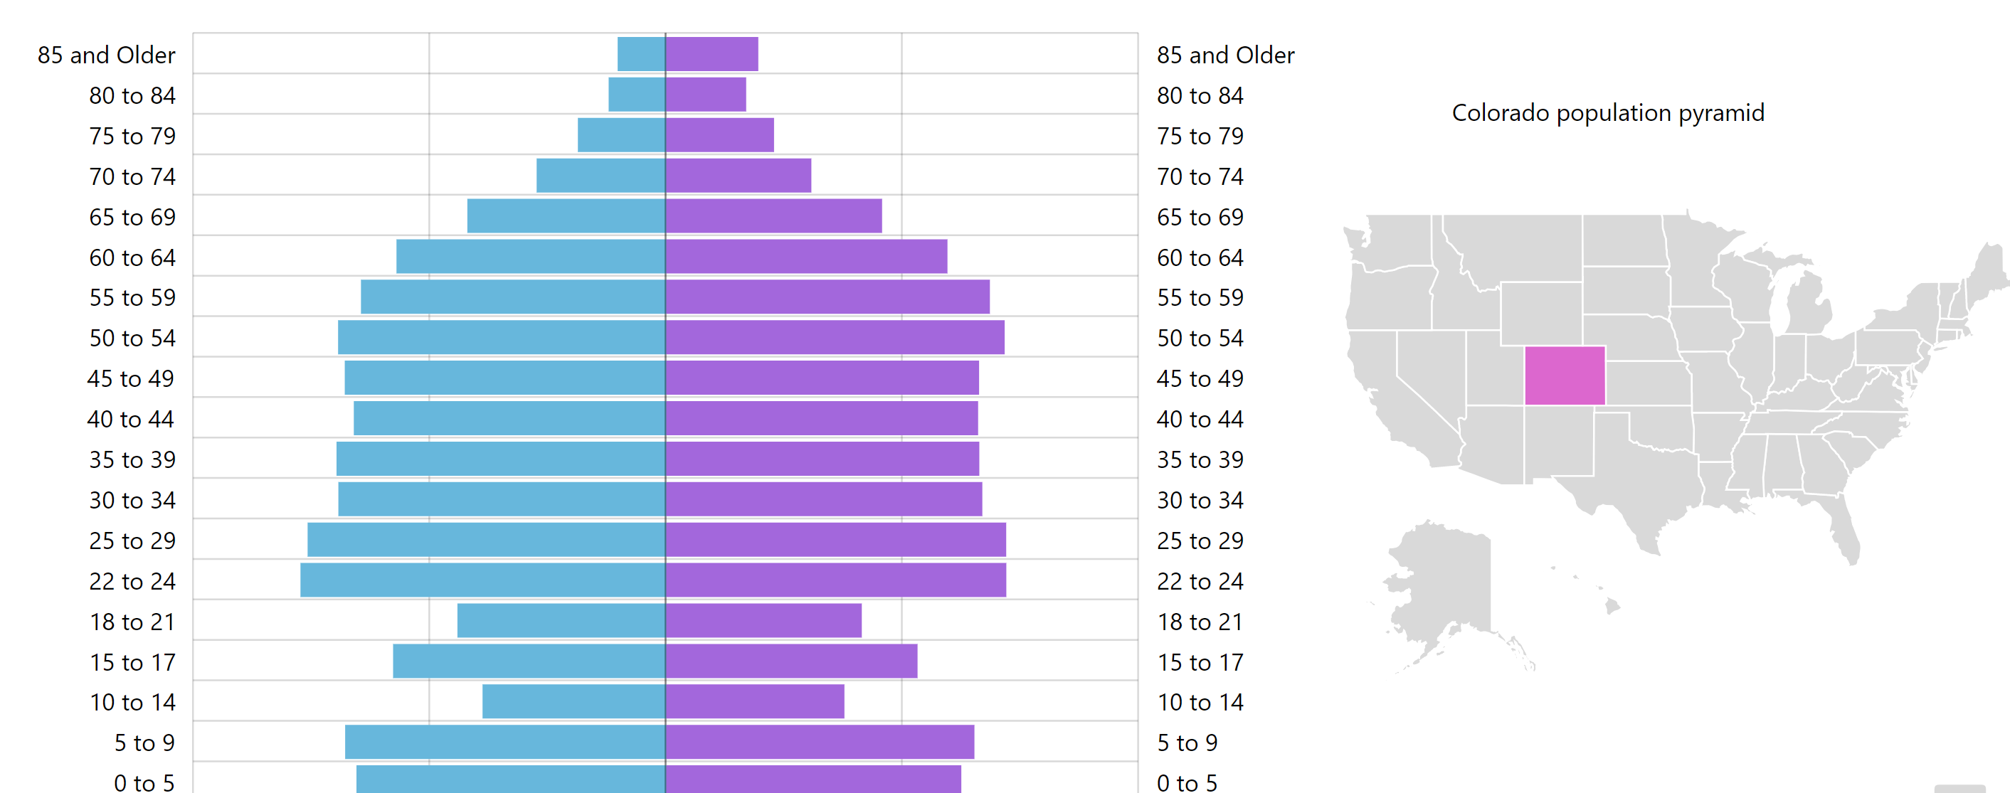
Age Groups – Toggle by Zip Codes
Details by Zip Codes

Slide 12
Alternative Dashboard Corrections

Slide 13
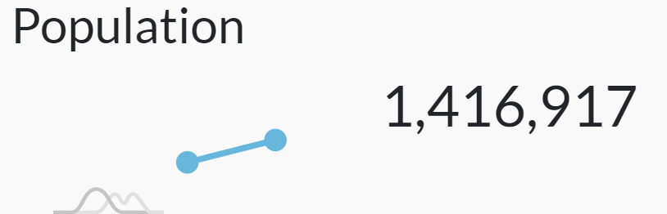


Enlarged Views – 5-Year Projection Format
Remove comma in year
Pop is supposed to show Current Year figures
2,023: 1,414,917

Slide 14
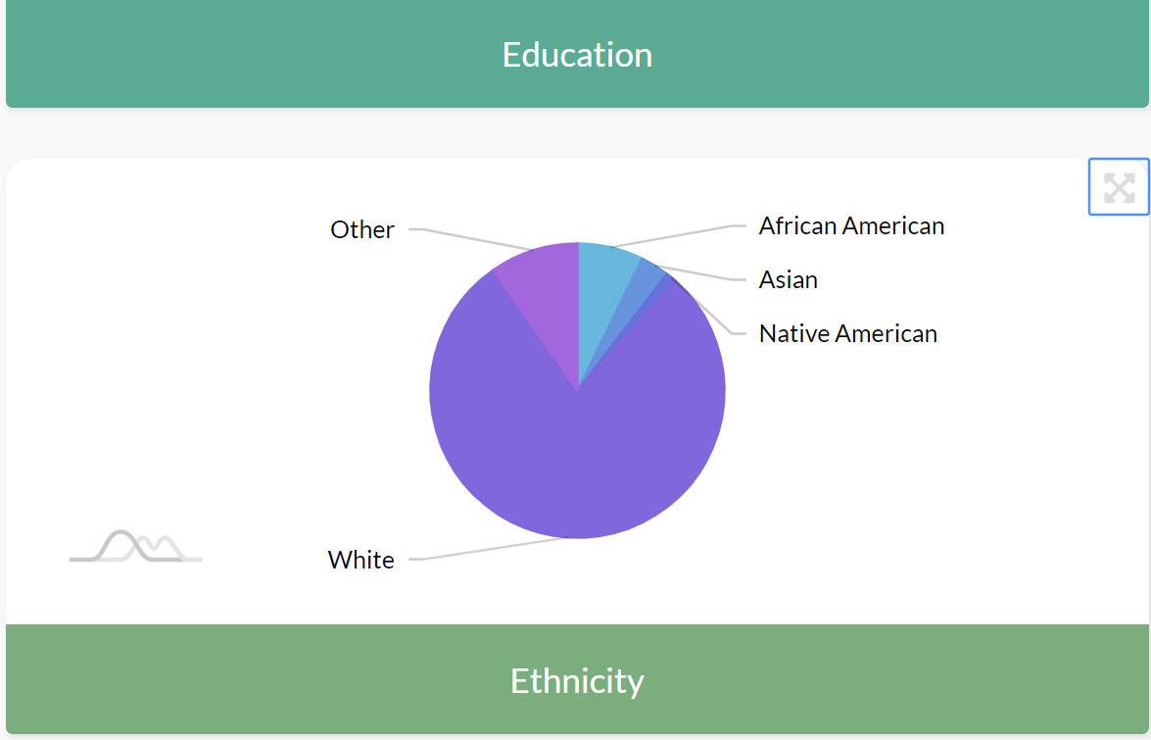
Ethnicity – Add Hispanic Population to Pie Chart
Add Hispanic population – it’s a separate field in the data set
Hispanic Pop

Slide 15

Maps View – Sector and Location Alignment
Remove comma in year

Slide 16
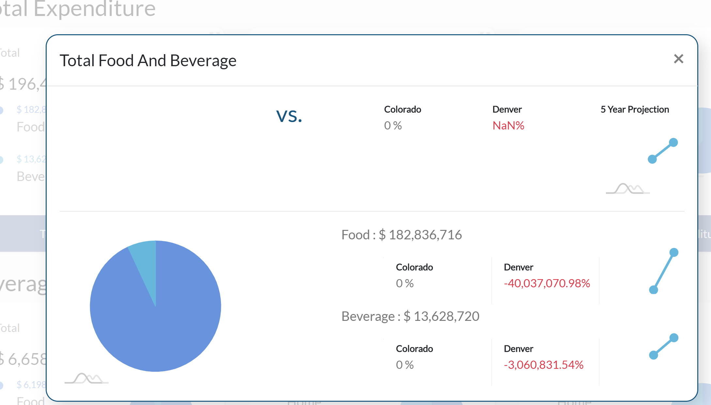
Expenditure – Comparison Percentage Calc Error
Correct calculations for State and City

Slide 17
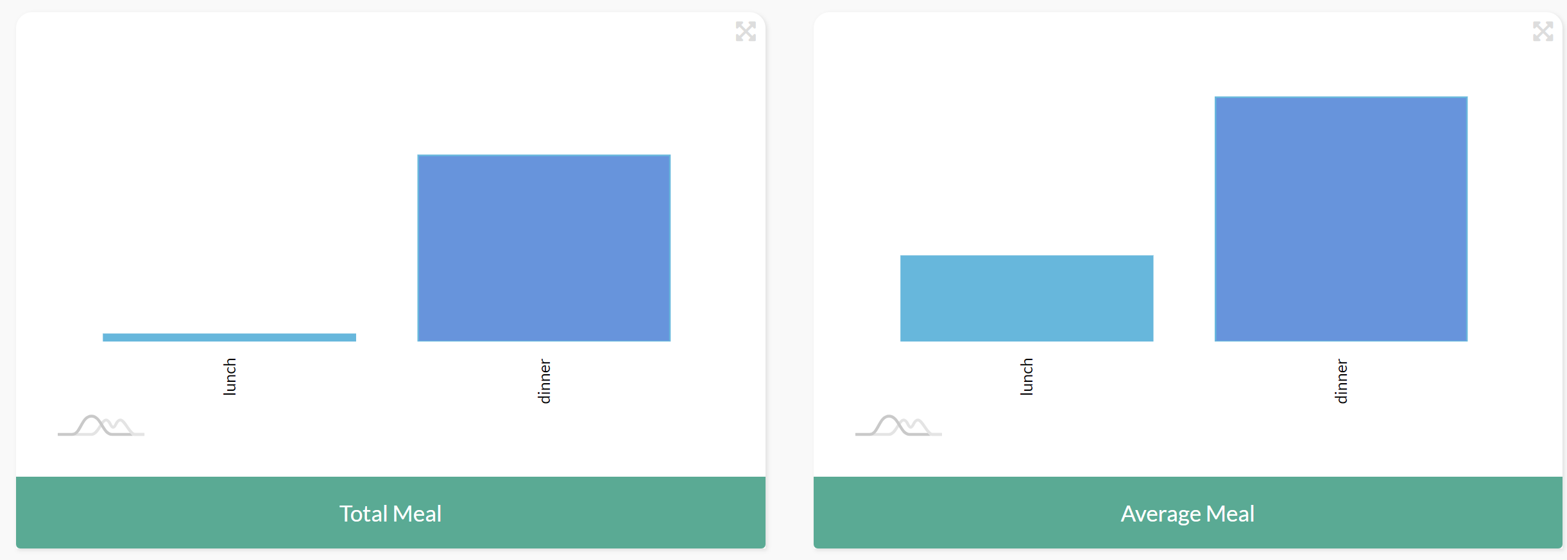
Total & Average Meal – Axis and Label
Add X axis on both charts (in Millions)

Slide 18
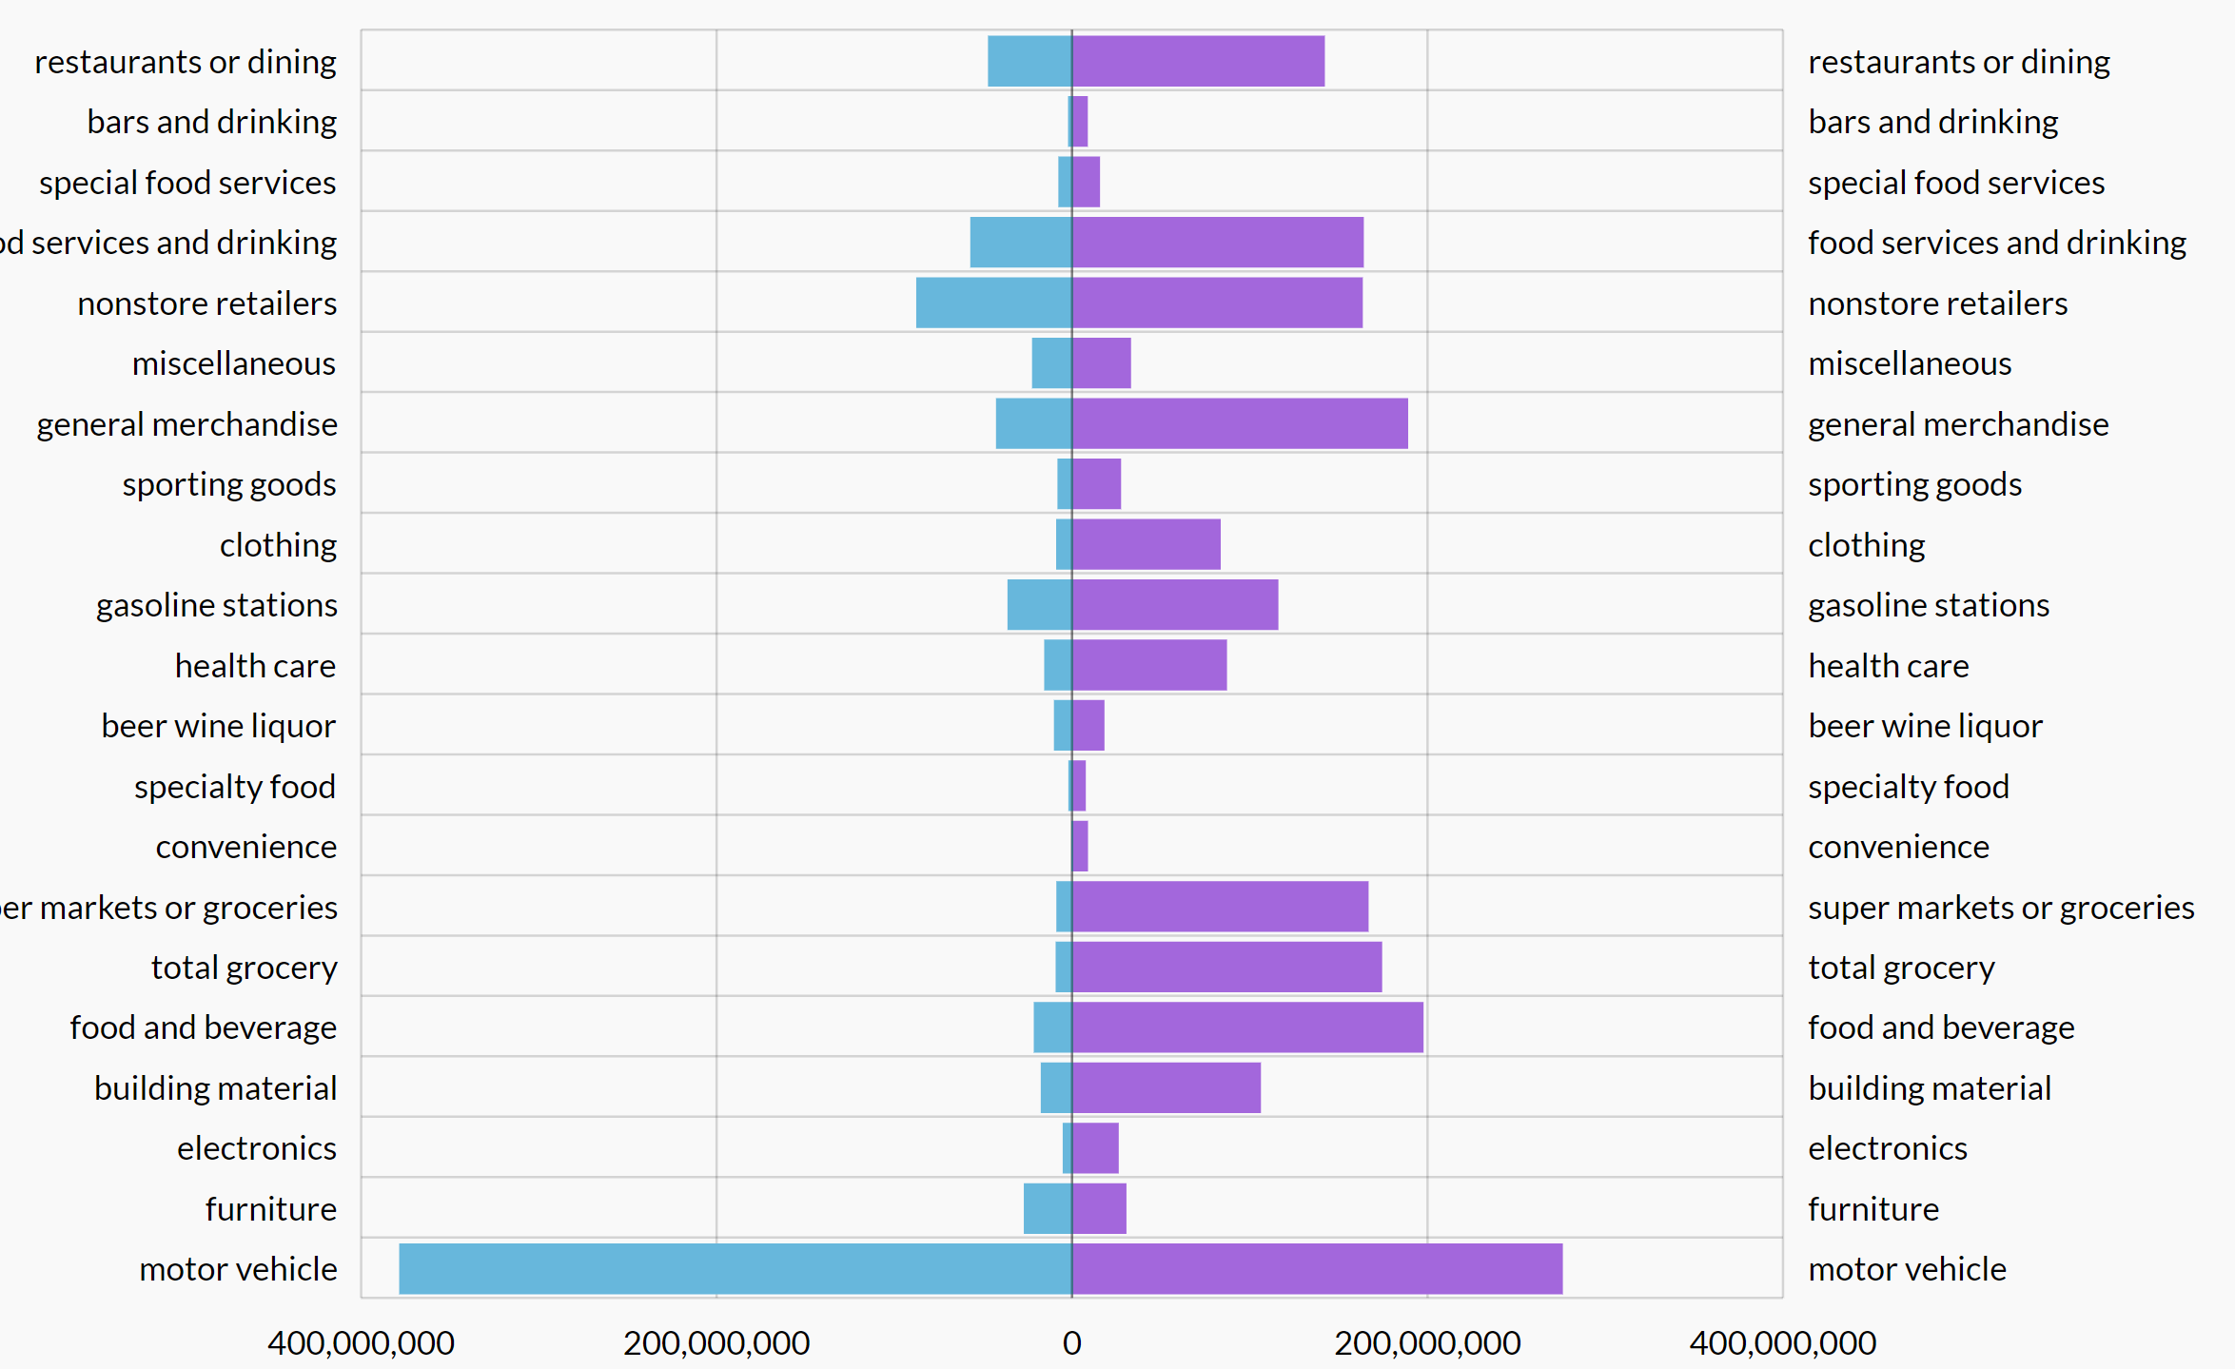
Retail Supply/Demand – Likely Data Read Issue
Something looks whacky in the data

Slide 19
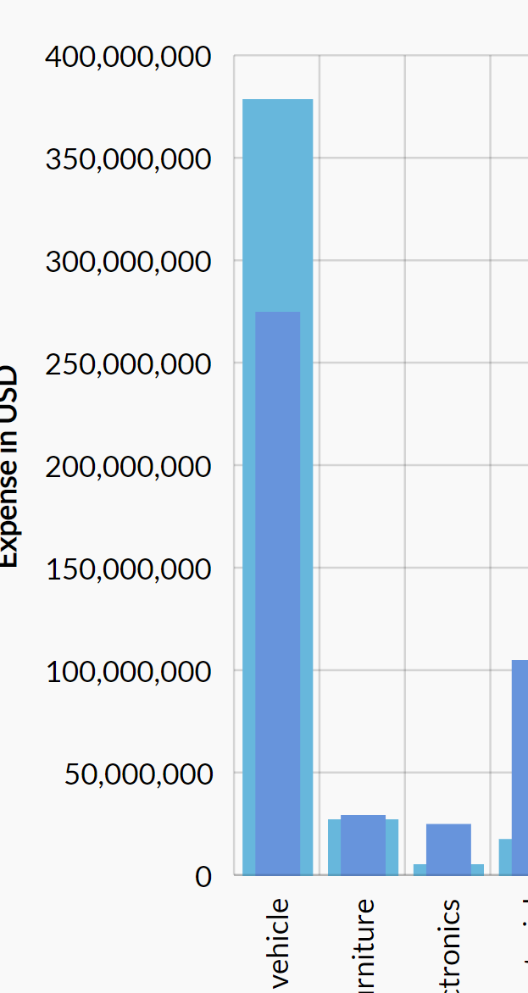
Chart Data – Axis Data Labels
We need conditional statement to limit the number of zeros in the chart labels:
If number > = one million, show in Thousands
If number > = one thousand, show in Hundreds
Adjust the minimum – let’s not have charts unnecessarily showing from zero

